Slide 1

Credit Ranking System
Supervisor: Mr. QuangLT

Slide 2
Contents
1
Introduction – 15 min
2
Plan – 5 min
3
Development process – 30 min
4
Demo – 10 min
5
Q&A – 30 min

Slide 3
Project management
Quality Assurance
Result
Introduction
Group
GROUP INTRODUCTION
Project name: Credit Ranking System
Supervisor: Mr. Quang LT
Students:
- Đào Mai Ly
- Trần Thị Hương Giang
- Phạm Thị Phương Thảo
- Phan Lê Quang Chính
- Nguyễn Thanh Long
Presentation view-point
Business context
Plan
Development process
SRS
Design
Implement
Testing
Demo
Q&A

Slide 4
Project management
Quality Assurance
Result
Introduction
BUSINESS CONTEXT
Group
Presentation view-point
Finance
Banking
Business context
Deposit
Others
Credit
Ranking
Plan
Development process
AAA
AA
A
BBB
BB
B
CCC
CC
C
D
Business
customer
Individual
customer
SRS
Design
Implement
Evaluation Ranks
Financial Index
Non Financial Index
Business Scale
........
Basic Index
Collateral Index
........
Testing
Demo
Q&A

Slide 5
Project management
Quality Assurance
Result
Introduction
Group
PRESENTATION VIEW-POINT
Follow process groups:
Requirements => Integration Testing
Each process contains 2 two parts: group working method and result
Quality assurance follows all the processes
Presentation view-point
Business context
Plan
Development process
SRS
Design
Implement
Testing
Demo
Q&A

Slide 6
Project management
Quality Assurance
Result
Introduction
Classifying
Group
BUSINESS CONTEXT
Presentation view-point
Business Process conclusion
Business context
Plan
Input
Process
Output
Customer
Rank
Development process
Customer
Info
Ranking
SRS
Design
Implement
Testing
Clustering
Demo
New Approach
Q&A

Slide 7
Project management
Quality Assurance
Result
BUSINESS CONTEXT
THE TWO APPROACH OF RANKING CREDIT
OLD SOLUTION
NEW SOLUTION
Simple technique
Data mining Clustering technique
Customer
AAA
BBB
CC
Fixed!
Flexible

Slide 8
Project management
Quality Assurance
Result
Introduction
Role
Group
Presentation view-point
Role | Tasks in charge
Project manager Nguyen Thanh Long | Work out the plan and time table Team contact point General manage project Design, code, review, create reports
Developer, designer Phan Le Quang Chinh | Support technique Design, code, review, create reports In charge of Mining module
Developer, designer Dao Mai Ly | Support technique Design, code, review, create reports In charge of Ranking module
Developer, tester and QA Tran Thi Huong Giang | Design, code, review, create reports In charge of Testing and QA tasks Create test case, test data, operate IT
Developer, tester and QA Pham Thi Phuong Thao | Code, review, create reports In charge of Testing and QA tasks Create test case, operate IT Manage meeting minutes
Business context
Plan
Development process
SRS
Design
Implement
Testing
Demo
Q&A

Slide 9
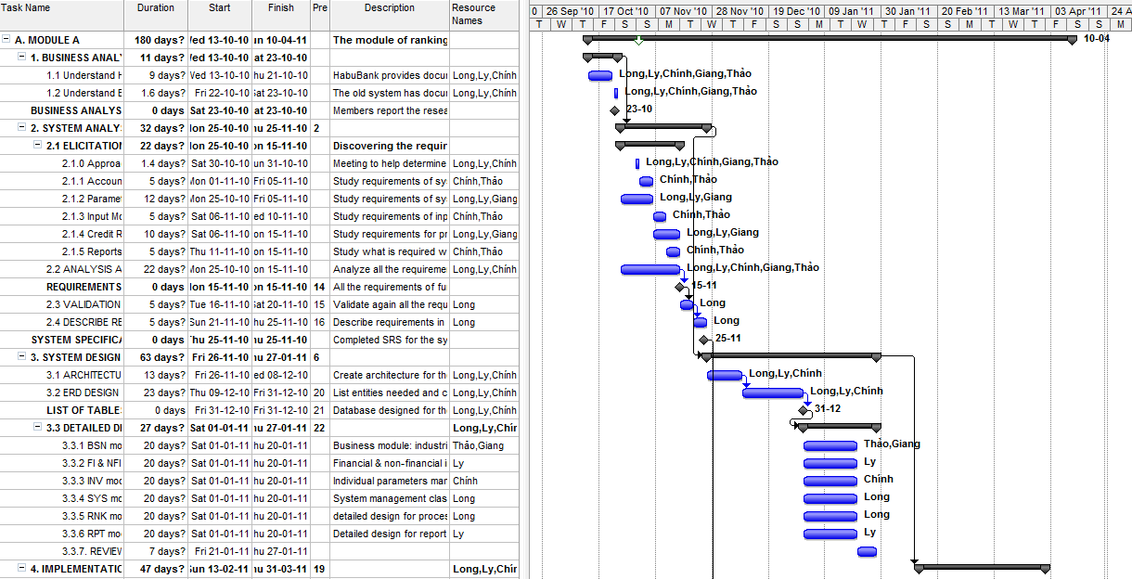
Project management
Quality Assurance
Result
Project Plan

Slide 10
Project management
Quality Assurance
Result
Introduction
Time table
Group
Presentation view-point
Project management
Business context
Quality Assurance
Review
Plan
Feasibility study
Require
ment
Create TC
Integration test
Deploy
Development process
DB & AD
Implement
DD
SRS
Design
Oct
Nov
Dec
Jan
Feb
Mar
Apr
Implement
Testing
Demo
Q&A

Slide 11
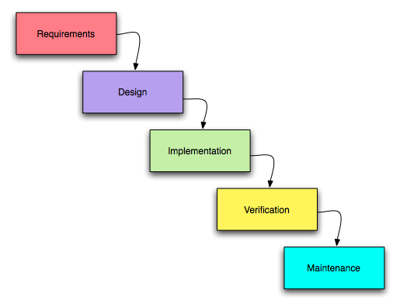
Project management
Quality Assurance
Result
Introduction
Process model – Waterfall model
Group
Presentation view-point
Reason:
Simple and familiar model
Report submitting schedule
Business context
Plan
Development process
SRS
Design
Implement
Testing
Demo
Q&A

Slide 12
Project management
Quality Assurance
Result
Introduction
Working process
Group
Plan
Do
Review
Log bugs
Presentation view-point
Business context
Plan
Development process
SRS
Design
Implement
Testing
Demo
Q&A

Slide 13
Project management
Quality Assurance
Result
Introduction
Cross-Review method
Group
Presentation view-point
SRS & DD review: cross-review between 2 teams
Business context
Code review: Person who designed the module will review code for this module -> form a review circle.
Plan
Development process
Long
Giang
Thảo
Ly
Chính
Advantages:
Review from different view-point
All member can understand what others is doing
All members can understand the whole system
SRS
Design
Implement
Testing
Demo
Q&A

Slide 14
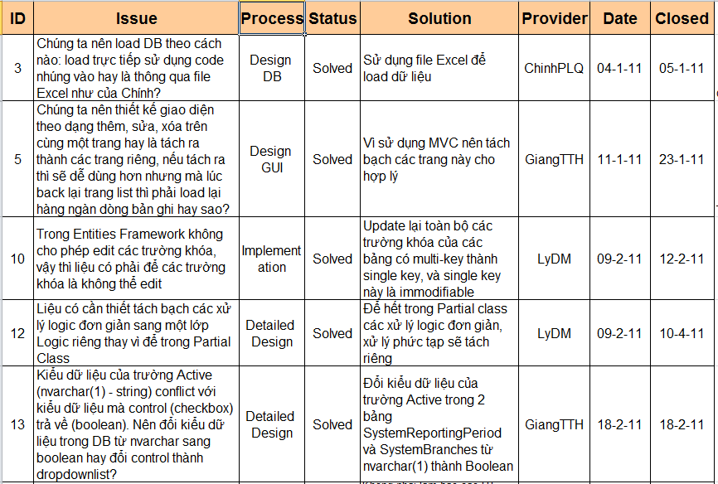
Project management
Quality Assurance
Result
Working process – Issue management

Slide 15
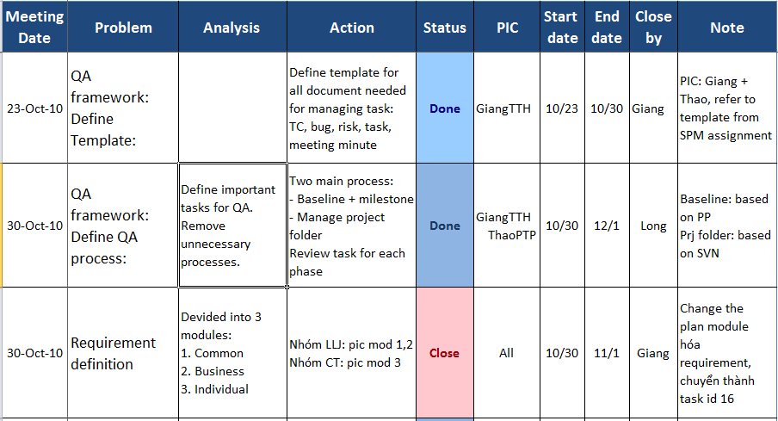
Project management
Quality Assurance
Result
Working process – Task management

Slide 16
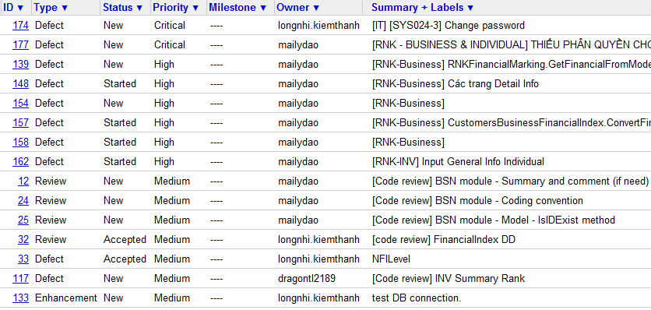
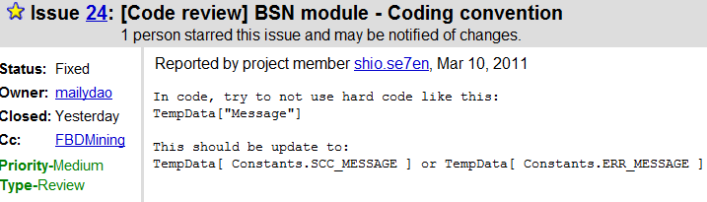
Project management
Quality Assurance
Result
Working process – Bug management

Slide 17
Project management
Quality Assurance
Result
Introduction
Group
BSN | FI NFI | INV | SYS |RNK |RPT
Presentation view-point
Business context
Plan
Elicitation
Analysis &
Negotiation
Development process
SRS
Documenting
Validation
Design
Implement
Testing
Demo
Q&A

Slide 18
Project management
Quality Assurance
Result
BUSINESS CONTEXT
CREDIT RANKING PROCESS FOR BUSINESS CUSTOMERS
Credit dept
manager
Risk managing
staff
Risk dept
manager
Branch
Director
Credit staff
Receive request ranking
Request for updating
Collect customer information
Identify customer’s industry operation
Marking for Financial Indexes
Marking for Non-Financial Indexes
Calculate total score
Summary Evaluation
Validation
Evaluation
Verified
Accepted
Committing Result

Slide 19
Project management
Quality Assurance
Result
BUSINESS CONTEXT
CREDIT RANKING PROCESS FOR INDIVIDUAL CUSTOMERS
Credit dept
manager
Risk managing
staff
Risk dept
manager
Branch
Director
Credit staff
Receive request ranking
Request for updating
Collect customer information
Marking for Basic information
Marking for Other information
Calculate total score
Summary Evaluation
Validation
Evaluation
Verified
Accepted
Committing Result

Slide 20
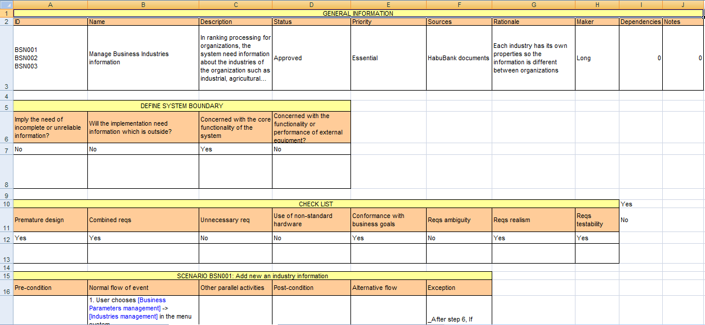
Project management
Quality Assurance
Result
Introduction
SRS Template
Group
Presentation view-point
Business context
Plan
Development process
SRS
Design
Implement
Testing
Demo
Q&A

Slide 21
Project management
Quality Assurance
Result
Introduction
Review action:
Review within sub-team.
Cross-review of two sub-team
Customers clarification.
Group
Presentation view-point
Business context
Plan
Development process
SRS
Design
Implement
Testing
Demo
Q&A

Slide 22
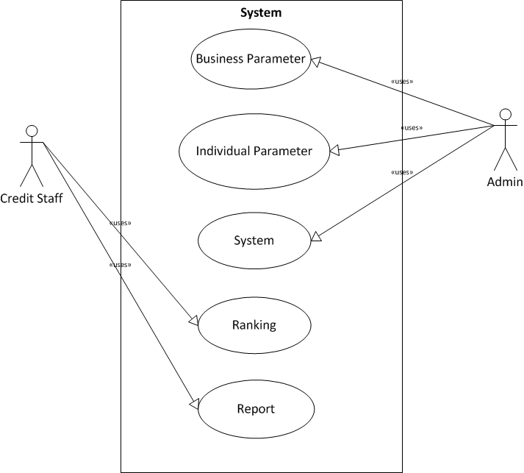
Project management
Quality Assurance
Result
Introduction
Group
Presentation view-point
Business context
Plan
Development process
SRS
Design
Implement
Testing
Demo
Q&A

Slide 23
Project management
Quality Assurance
Result
Introduction
NON FUNCTIONAL
Group
Presentation view-point
Reliability
Security
Portability
Performance
ID | Metric | Requirement
REL001 | POFOD (Probability of failure on demand) | 0.002 In 500 of service requests may result 1 failure on demand
REL002 | ROCOF (Rate of failure occurrence) | 0.005 In 1000 operational time units, there are 5 failures likely to occur
REL003 | MTTF (Mean time to failure) | 720(h) Mean time between two successive failures is 720h
REL004 | AVAIL (Availability) | 0.950 In 1000 hours of operation, the system must be available for at least 950h
REL005 | MTTR (Mean time to repair) | 24(h) The system is allowed 24h to be out of operation after it has failed
REL006 | DR Defect rate | 1 bug / KLOG (thousand lines of code)
ID | Type
SEC001 | Identification
SEC002 | Authentication
SEC003 | Authorization
SEC004 | Privacy
SEC005 | Immunity
SEC006 | Integrity
Business context
ID | Type | Requirement
POR001 | Program portability | The system must be deployed as an Extranet Website and required to be run successfully on Internet Explorer 7 or upper and other popular browsers such as Firefox and Google Chrome
POR002 | Data portability | The data of the system must be stored using SQL Server Express 2005 or Oracle database
POR003 | End-user portability | The system is required to have the same look and feel across different browsers. All are displayed according to the standard of Website user interface design: The form of index pages will list all the record, and there is a link to the add, edit and remove page. All the button of saving changes or adding will be put at the bottom of the textboxes. When there are some errors occurred, display red message to the users and require them to do again (if possible). After successfully changing the data, display notification to users. All pages of the application will have the same menu and users can access to functionalities of the system from here.
ID | Type | Requirement
PER001 | Response time | The average time to response for a transaction when managing parameters is 2s and the maximum is 5s. The average time to response for a transaction when ranking for customers is 3s and the maximum is 8s
PER002 | Capacity | The system can accommodate for a maximum number of 1000 users at different locations
Plan
Development process
SRS
Design
Implement
Testing
Demo
Q&A

Slide 24
Project management
Quality Assurance
Result
Introduction
I. DB design
Goal:
Solve business requirement.
Try following 3 Normal Form.
Inherit customer data
Approach:
Bottom up
Design and edit, review, merge in Visio then create DB
Result:
Group
Presentation view-point
Business context
Plan
Development process
SRS
Design
Implement
Testing
Demo
Q&A

Slide 25
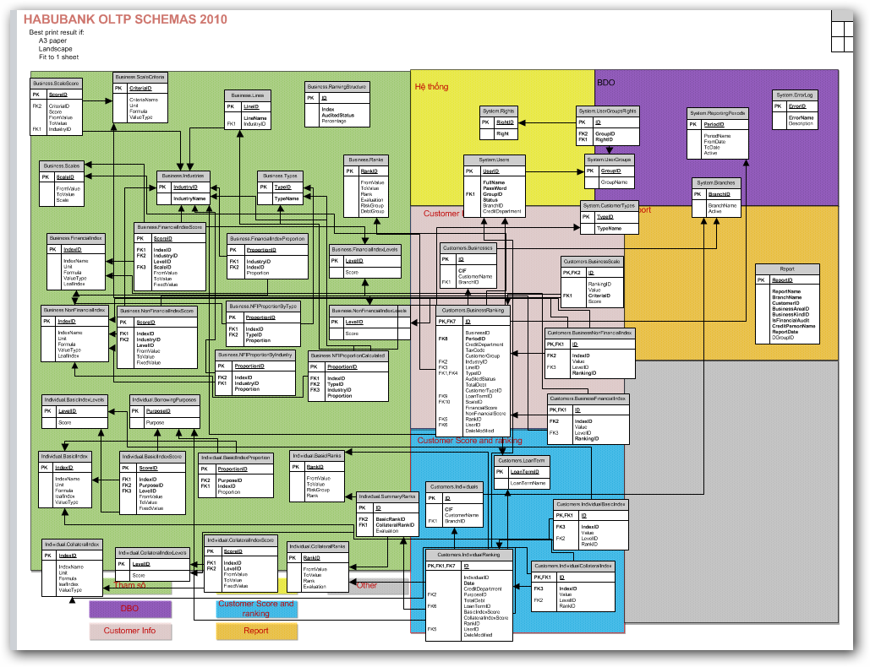
Project management
Quality Assurance
Result
Introduction
DB design
Group
Presentation view-point
Business context
Plan
Development process
SRS
Design
Implement
Testing
Demo
Q&A

Slide 26
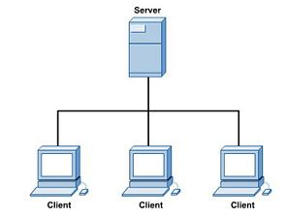
Project management
Quality Assurance
Result
Introduction
II. System Design
Base on non-Functional requirement:
Need a lot of user using common DB
Group
Presentation view-point
Business context
Plan
Development process
SRS
Design
Implement
Testing
Demo
Q&A

Slide 27
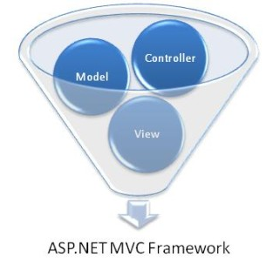
Project management
Quality Assurance
Result
Introduction
MVC architecture
Group
Presentation view-point
Framework : Using MVC( Microsoft MVC .Net 2.0)
Advance :
beside common advance, it save our time
Business context
Plan
Development process
SRS
Design
Implement
Testing
Demo
Q&A

Slide 28
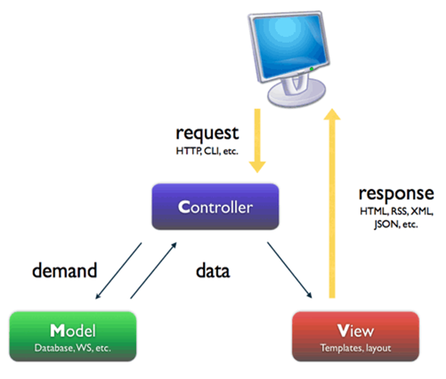
Project management
Quality Assurance
Result
Introduction
MVC architecture
Group
Presentation view-point
Business context
Plan
Development process
SRS
Design
Implement
Testing
Demo
Q&A

Slide 29
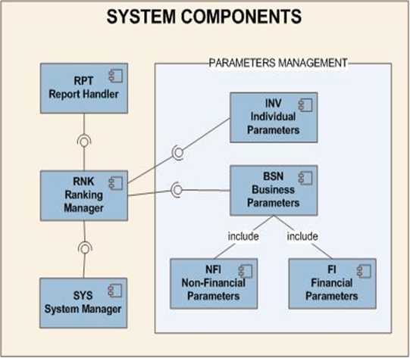
Project management
Quality Assurance
Result
Introduction
Component Diagram:
Group
Presentation view-point
Business context
Plan
Development process
SRS
Design
Implement
Testing
Demo
Q&A

Slide 30
Project management
Quality Assurance
Result
Introduction
Detail design
Goal:
Describe all class, function in this program
Approach:
Bottom up:
each person design a function,
Using our excel template and MS Visio.
Result
Group
Presentation view-point
Business context
Plan
Development process
SRS
Design
Implement
Testing
Demo
Q&A

Slide 31
Project management
Quality Assurance
Result
Introduction
Implemented modules
Goal:
Build a system fulfill requirement onetime.
Approach:
Bottom-up
Using Google code, svn and ankhsvn( visual studio add-in) to manage source
Result: Demo(late)
Group
Presentation view-point
Business context
Plan
Development process
SRS
Design
Implement
Testing
Demo
Q&A

Slide 32
Project management
Quality Assurance
Result
Introduction
Implemented modules
Group
Presentation view-point
Business context
Administration
Plan
Parameters
Development process
Ranking
SRS
Design
Clustering
Implement
Testing
Demo
Report
Q&A

Slide 33
Project management
Quality Assurance
Result
Introduction
K-means algorithm
1.Definite:
k-means clustering is a method of cluster analysis which aims to partition n observations into k clusters in which each observation belongs to the cluster with the nearest mean.
Group
Presentation view-point
Business context
Plan
Development process
SRS
Design
Implement
Testing
Demo
Q&A

Slide 34
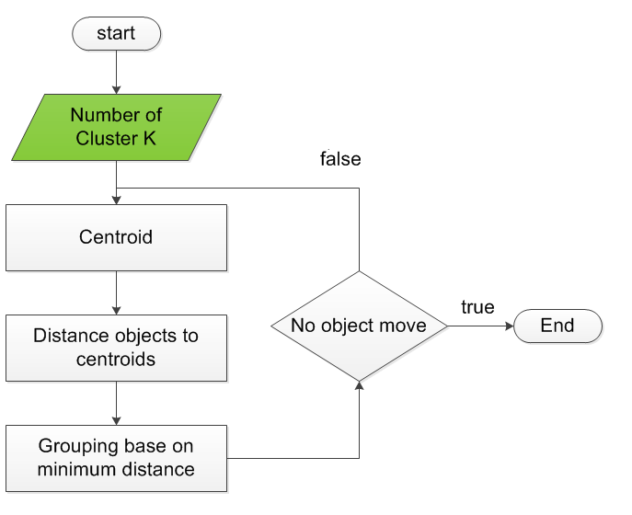
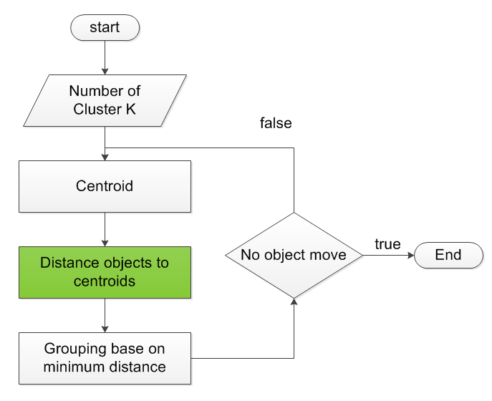
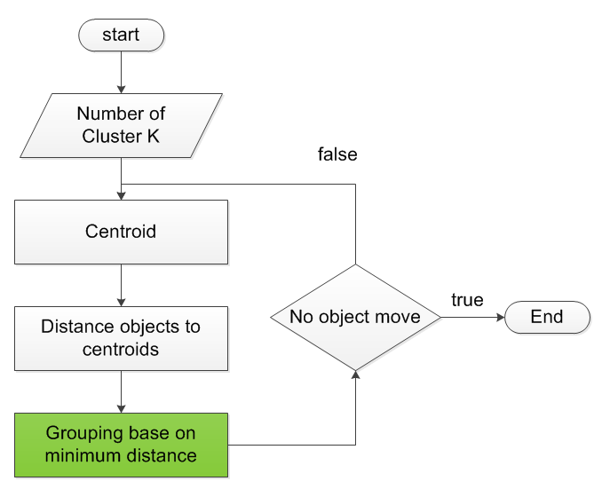
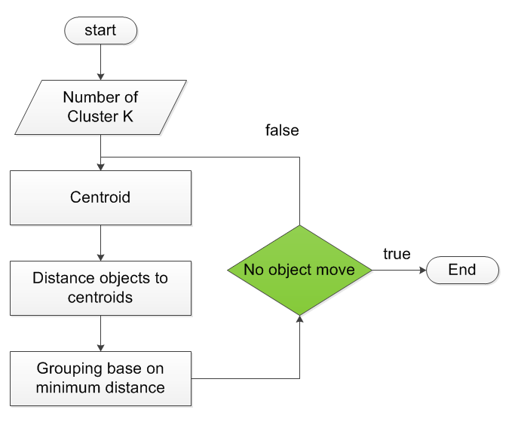
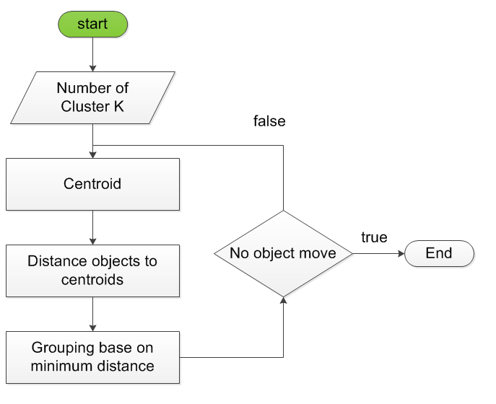
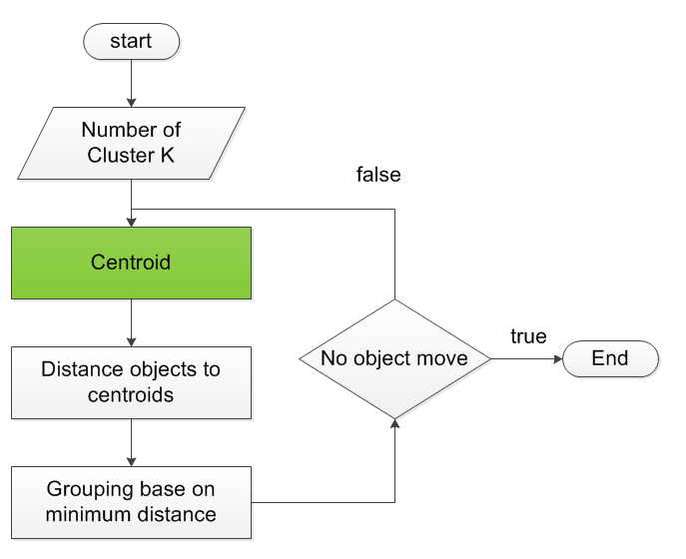
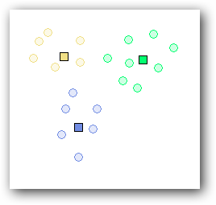
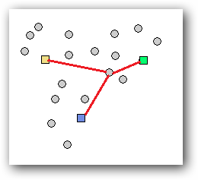
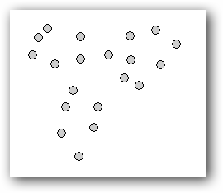
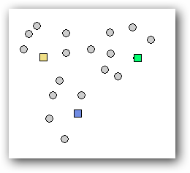
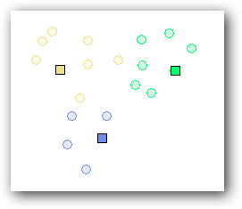
Project management
Quality Assurance
Result
2. K-means Algorithm flow char

Slide 35
Project management
Quality Assurance
Result
Introduction
3.Apply:
Each customer is considered a vector.
Business customer: one dimension vector.
Individual customer: two dimension vector
(x: collateral index; y: basic index)
Data sample is all customers in a period report
k determine from habubank
Group
Presentation view-point
Business context
Plan
Development process
SRS
Design
Implement
Testing
Demo
Q&A

Slide 36
Project management
Quality Assurance
Result
Introduction
Testing activities
Code
Unit test
Review code
Integration test
Log bug
Group
Presentation view-point
Business context
Plan
Development process
SRS
Design
Implement
Testing
Demo
Q&A

Slide 37
Project management
Quality Assurance
Result
Introduction
Test strategy follows V-model
Group
Presentation view-point
Developing
Testing
Business context
Coding
Acceptance
System
Integration
Unit
Requirements
High-level design
Detailed design
Plan for
Plan
Development process
SRS
Design
Implement
Testing
Demo
Q&A

Slide 38
Project management
Quality Assurance
Result
Introduction
Testing process
Group
Presentation view-point
Create TC template
Write TC (based on SRS)
Review TC
Create test data
IT
Business context
Plan
Development process
SRS
Design
Implement
Testing
Demo
Q&A

Slide 39
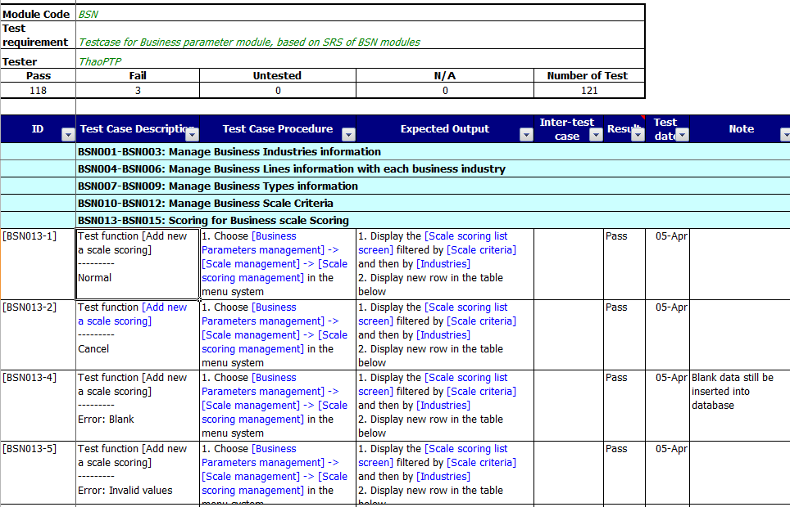
Project management
Quality Assurance
Result
Introduction
Test case
Group
Presentation view-point
Business context
Plan
Development process
SRS
Design
Implement
Testing
Demo
Q&A
Test case

Slide 40
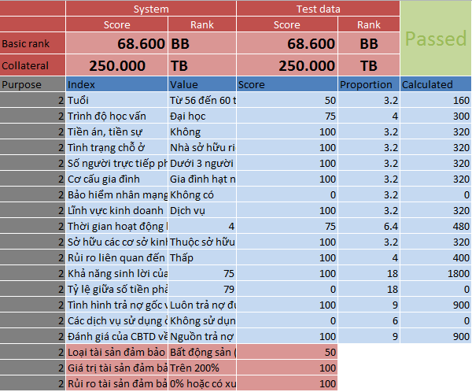
Project management
Quality Assurance
Result
Introduction
Test data
Group
Presentation view-point
Business context
Plan
Development process
SRS
Design
Implement
Testing
Demo
Q&A

Slide 41
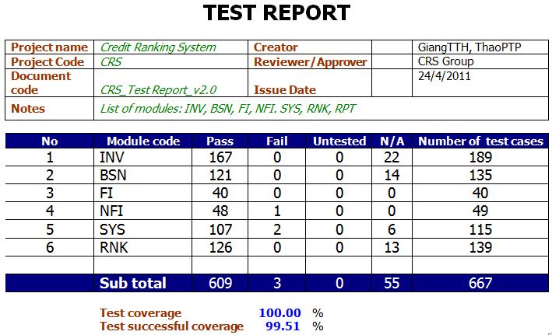
Project management
Quality Assurance
Result
Introduction
Test report
Group
Presentation view-point
Business context
Plan
Development process
SRS
Design
Implement
Testing
Demo
Q&A

Slide 42
DEMO

Slide 43
Q&A

Slide 44
Thanks for listening!

